Slide 1
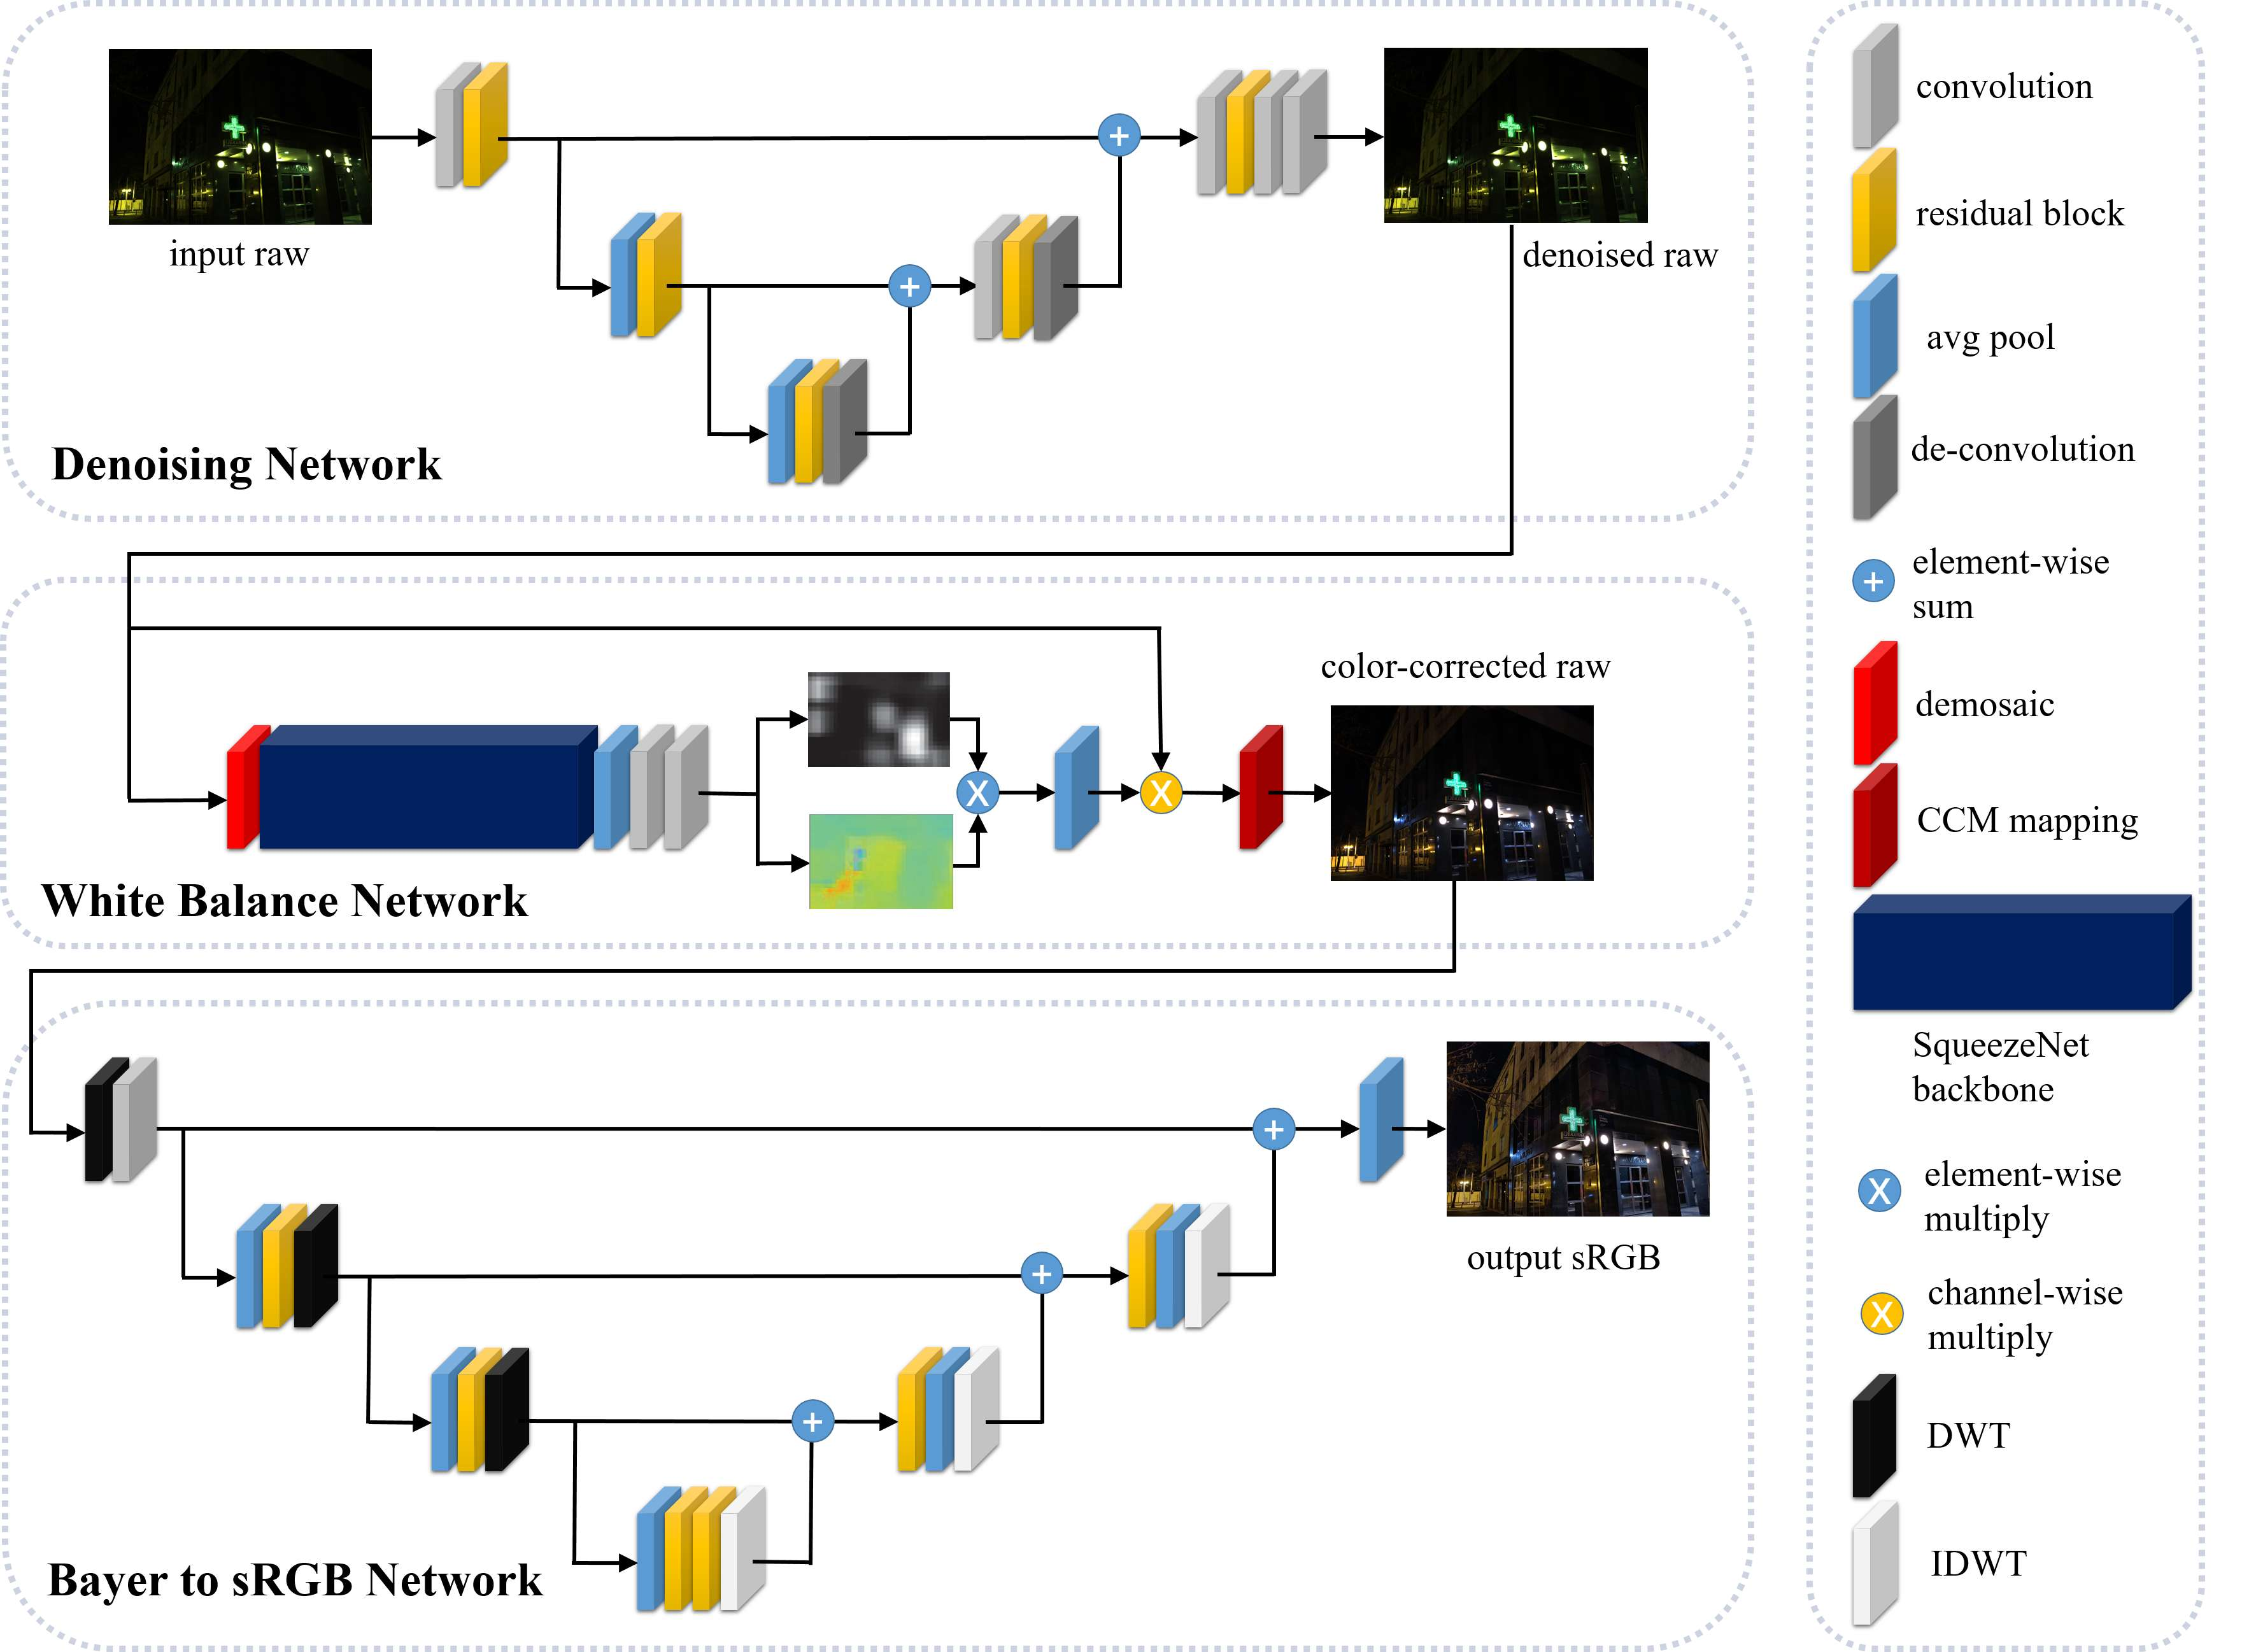
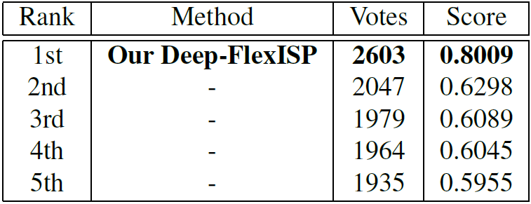
Deep-FlexISP: A Three-Stage Framework for Night Photography Rendering Shuai Liu, Chaoyu Feng, Xiaotao Wang, Hao Wang, Ran Zhu, Yongqiang Li, Lei Lei Xiaomi Inc., China
Introduction
Night photography rendering is challenging due to images’ high noise level, less vivid color, and low dynamic range. In this work, we propose a three-stage cascade framework named Deep-FlexISP, which decomposes the ISP into three weakly correlated sub-tasks: raw image denoising, white balance, and Bayer to sRGB mapping.
Overall Workflow
Many studies shown that the denoising performance in the raw domain is better than the RGB domain. Denoising in the raw domain can remove noise better and retain more details. So we first put the original raw image into the denoising network to get a noise-free raw image. Second, the denoised raw image will go through the white balance network to estimate the RGB gain parameters. After the color is corrected, the Bayer to sRGB network will map the raw image to the final output sRGB image. Bayer to sRGB mapping includes demosaic, tone-mapping, etc.
Experiment result
Simple ISP baseline [1]
Motivation
First, task decomposition can enhance the learning ability of the framework and make it easier to converge. Second, weak correlation sub-tasks do not influence each other too much, so the framework has a high degree of freedom. Finally, noise, color, and brightness are essential for night photographs. Our framework can flexibly adjust different styles according to personal preferences with the vital learning ability and the degree of freedom.
PyNet [2]
Night Photography Rendering Challenge of NTIRE
In the night photography rendering challenge of NTIRE, using the proposed Deep-FlexISP, we achieve the first place in both the people’s choice and the photographer’s choice. In particular, in the people’s choice, we are ahead by a considerable margin, which proves the effectiveness of our method.
HERN [3]
Our Deep-FlexISP
[1] https://github.com/createcolor/nightimaging
[2] Andrey Ignatov, et al. Replacing mobile camera isp with a single deep learning model.
CVPRW, 2020.
[3] Kangfu Mei, et al. Higher-resolution network for image demosaicing and enhancing.
ICCVW, 2019.

